Slide 1
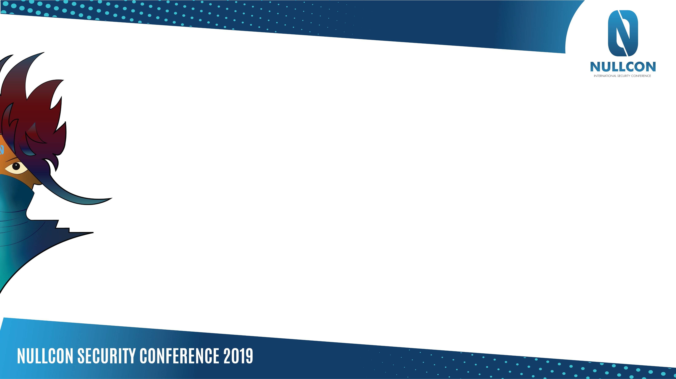
EDR Internals and Bypasses
Notes:
Talking about EDRs, how they work within an OS (windows focus), and get into the good stuff (complete bypasses).
I'll address the question of WHY, why is this important or why research this in the first place, and set some background on this topic before we dive into the heavier stuff.

Slide 2
Who Am I?
Consultant at Context Information Security
@Kharosx0
Notes:
First, a couple snippets about me.
Any questions reach out on twitter

Slide 3
Goals
Demonstrate EDR capabilities
Analyze Internal details of EDRs
Demonstrate complete bypasses
Live demo fun ☺
Notes:
WHY do this?
Well, a bit of background, its becoming more common to see EDRs like carbon black or cylance installed on endpoints in high-secure environments.
As I'll go into later, EDRs raise the bar from your typical AV.
Without experience or knowledge around how EDRs operate its easy to get caught out when performing say privilege escalation or post-exploitation on an EDR protected host.
Additionally, public awareness of how these EDRs operate internally or their weaknesses isn't that high, when you search online for AV bypasses you'd find many different techniques, a lot of them may be applied generically like "recompile without debug strings" and the like.
Generic bypasses are the most useful as they can target multiple products, for example modifying mimikatz from github generically can bypass many AV products, but the same knowledge about generic bypasses don't seem to exist online for EDRs.
Even certain specific bypasses that have been released previously typically affect only a subset of EDR products and then get patched.
What I really want you to get out of this talk is to not see EDRs as some sort of mysterious product, or magic. I want to demystify how they work so you can understand the technical inner workings of them.
Finally at the end there will be a bypass shown that generically bypasses a lot of EDRs and their protections, which is pretty cool.

Slide 4
Contents
EDR Introduction
General Capabilities
General Components
Windows & EDR Internals
Drivers & Devices
Callbacks
Patchguard
Self-Protection
Common Weaknesses + Live Demos
Notes:
Rough outline of the flow of this talk
I'll cover just enough windows internals that are key to how EDR's operate.
Then we have some demos, i always prefer to demonstrate what I'm talking about live if possible and time permits.

Slide 5
Why EDRs?
Notes:
This is probably one of the more important sections to understand, just for the simple fact to justify the research and understand how these products differ from traditional AV.

Slide 6
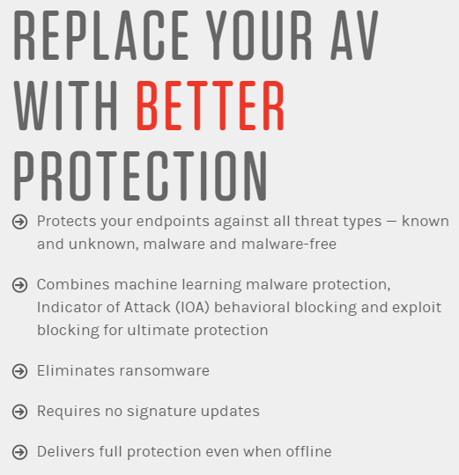
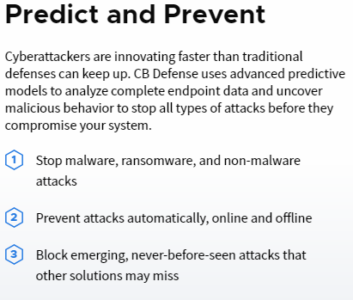
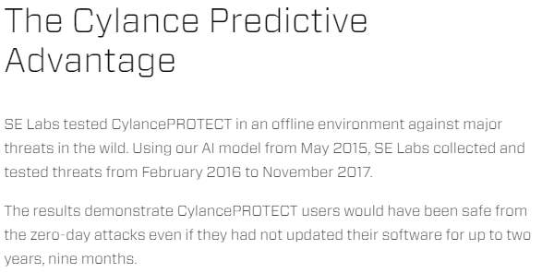
General Capabilities
AV-Like behavior
“Zero-day” protection
Behavioral based detection
Technical details? Not really
Free trial?
Notes:
For those that haven't heard of EDRs before, they are "Endpoint Detection and Response" products.
You can see some snippets of marketing from them here, advertising "zero-day" protection with a focus on behavioural analysis.
As mentioned before not much public research is available for these products compared to AV, one reason for this is the difficulty on obtaining one, and the secrecy on any technical details.
These vendors like to think their products have super secret sauce they need to be extra careful about, and so they don't tell you the technical details about their product.
Additionally, these products may offer free trials, however you generally have to request it in an email and they will assess who you are, and if they don't like you "because say, you're not a large company and instead just a security researcher", they will likely deny your trial request.
All of that makes it difficult to obtain and perform research on these products.

Slide 7
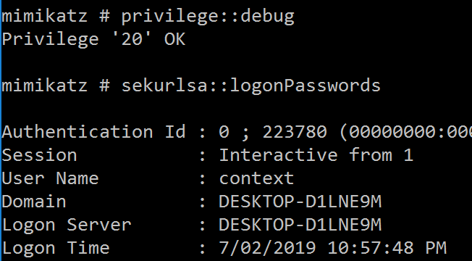
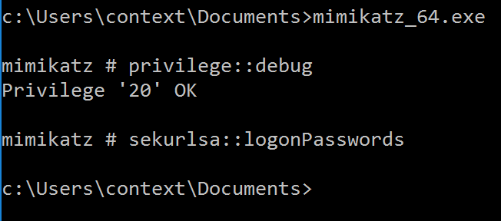
Prevention Capabilities
AntiVirus:
Obfuscation modifications:
EDR:
Obfuscation modifications:
Works
Terminated
Notes:
Here we see the behavioural prevention in practise.
We have a version of mimikatz here (for those that don;t know mimikatz, <explain mimikatz>
This mimikatz has been recompiled to bypass AV, we see on the left screenshot a system protected by AV, it allows mimikatz to run after we've recompiled it to bypass signatures.
On the right we have a machine protected by EDR, although it lets me start the application, when I attempt to dump passwords from lsass it detects that behavior and terminates the process before I could dump any passwords.
This is one key difference between traditional AV and EDRs, EDRs are quite good at detecting malicious behavior and blocking/reporting it. Making it quite risky to run such tools/techniques on an endpoint with EDR.

Slide 8
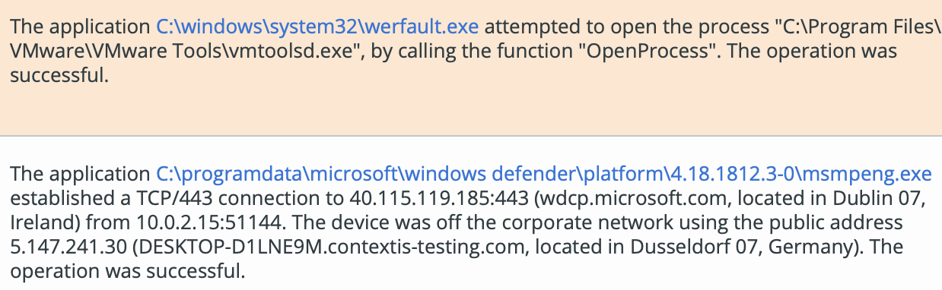
Detection & Logging
Powerful logging + querying = ☹
!?
Notes:
Here is what the logs may look like on the management console for these EDRs.

Slide 9
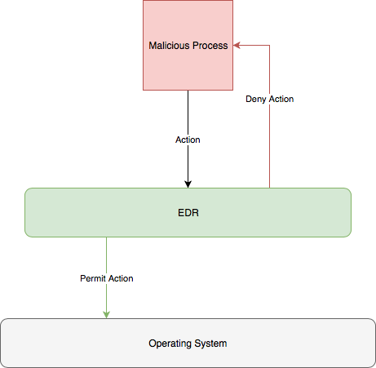
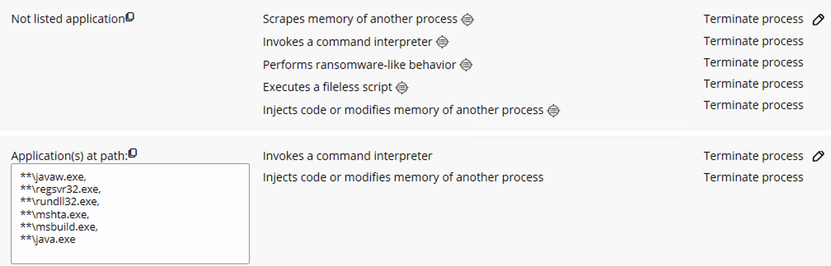
General Capabilities Pt.2
Notes:
From the logs we can infer EDRs must operate something like the image on the right. They need to have some insight into what operations we are attempting to perform to log the function and/or block it.
On the left you can see some options that reinforce this idea that it needs knowledge as to what we're doing.
This is key as we need to understand the HOW behind this, which we will get into later.
Another point i want to mention is that there is room for other weaknesses in this product I won't go into detail about, such as configuration weaknesses with weak blacklists (blacklisting apps by path rather than hash, etc).
I won't be going into the config weaknesses much because we can more generically bypass EDRs as I'll show later.

Slide 10
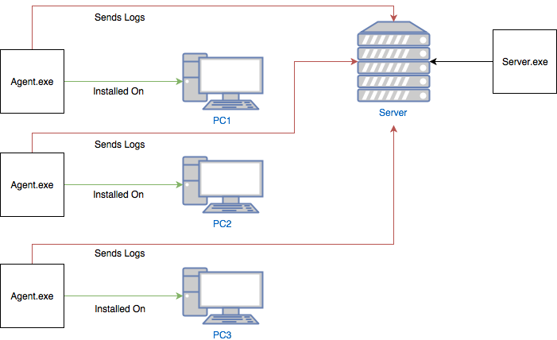
General Components
Filter Drivers
Network Drivers
Software Drivers/Components
Userland Apps
Notes:
General architecture
Hosts include userland apps and kernel drivers
Filter drivers for Disk IO
Network drivers for network polling/updates
Software driver components for callback handling
Userland apps for AV-like behavior and more as we will see later on
Good to see the attack surface of these agents
Not too critical to understand, but good to see

Slide 11
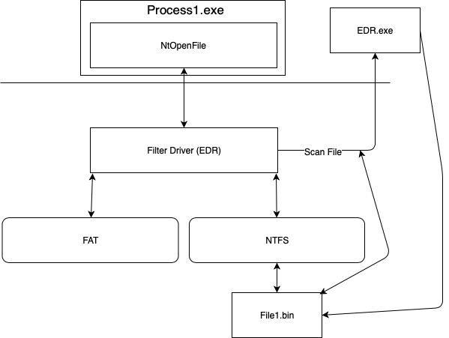
Key Component – filter Driver
Notes:
This is one component I want to dedicate a slide to, to further demonstrate EDRs capabilities.
Monitor disks (including removeable drives) on callback:
FltAllocateContext
FltSetInstanceContext
Doesn’t like your file open/create operation?
FltCancelFileOpen
Communicates with Usermode app via FltSendMessage & FltGetMessage
E.g. Command to scan specified file

Slide 12
Windows & EDR Internals
Notes:
As mentioned before, EDRs rely on what the OS exposes to assist with their job
EDRs also have to work within the restrictions of the OS (for the most part)
We will look into key components/functions/structures that support (or hinder) EDR operations
Crucial to understand how we may attack or bypass EDRs.
We are getting into the key parts of how EDRs operate now, which will directly lead into their weaknesses and generic bypasses. I'm sure some of you will quickly think of bypasses as soon as I go into their internals here. You'll probably have your suspicions confirmed when we reach the live demos.
This is because once you really understand how these EDRs operate, their weaknesses are quite apparent. I've seen some research of EDR bypasses before but none that really reverse engineer these products to find weaknesses, most of what i've seen is someone grabbing random techniques from a bucket of TTPs and throwing them against the EDR to see what sticks.
I take a different approach here and reverse the product to identify how it works and then infer and try bypasses based on this knowledge, which we will see the results shortly.
This is another key thing to remember, i recommend if you have time and are looking into bypassing any security product, it pays to spent time really understanding how the product works, sometimes the bypasses are easy to implement once you find them. Which was definitely the case here.

Slide 13
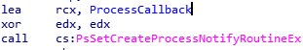
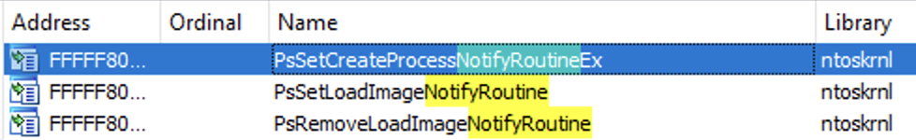
Callbacks
PsSetCreateProcessNotifyRoutine
PsSetLoadImageNotifyRoutine
PsSetCreateThreadNotifyRoutine
ObRegisterCallbacks (Handles)
PsProcessType
PsThreadType
CmRegisterCallbacks (Registry)
Demo: Viewing callbacks
Notes:
Callbacks are an integral mechanism for EDRs to operate, without them EDRs are generally useless.
You'll understand why very shortly
Ob callbacks are for handles
CM callbacks for registry operations
^ (important as certain EDRs use the registry to determine if bypass mode is enabled etc, falsifying this may trick an EDR into thinking bypass mode is enabled and stop it from blocking malicious actions)
With patchguard, callbacks are crucial for EDRs to operate (more on patchguard next)

Slide 14
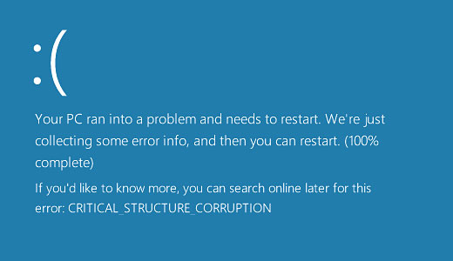
Patchguard Overview
Pseudorandom Event
Wake Patchguard Thread
Patchguard[Verify critical structure a*]
Sleep(1000)
Notes:
Patchguard was introduced to minimize shifty behavior in the kernel, as this was causing many of the BSODs microsoft saw.
Example of malware uses of kernel patching would be unlinking processes to hide them from the OS
Example of AV uses of kernel patching would be hooking the kernel syscall functions to monitor program API calls (we will see this next)

Slide 15
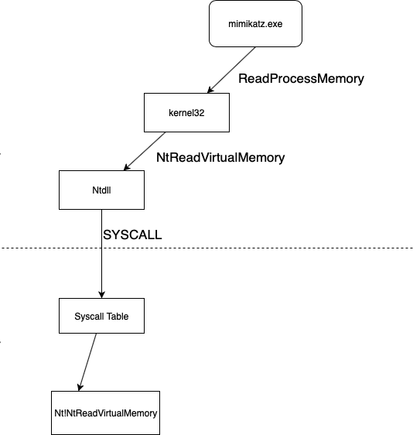

SYSCALLS & NTDLL
EDR.dll
Notes:
Normal flow, explain syscalls etc
Explain this is (patchguards fault) why EDRs cannot hook in the kernel to monitor what behavior/API calls an application is doing
Explain why they patch NTDLL to monitor behavior.

Slide 16
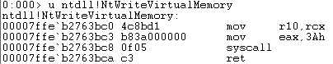
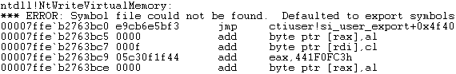

SYSCALLS pt.2
Notes:
0-day prevention = by hooking api calls and detecting malicious behavior
e.g. reading memory from lsass
Do a demo to show how not all processes are hooked (e.g. powershell_ise vs powershell.exe (not a generic bypass but something weird I noticed, not sure why they don't hook this).

Slide 17
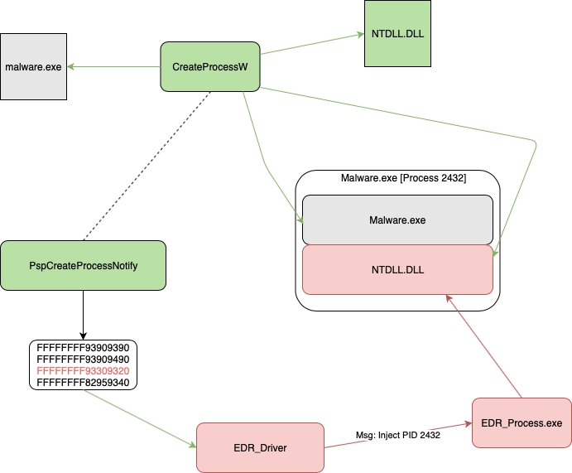
Q2. How Does The Hooking Occur?
Driver -> FltSendMessage (or similar)
UserApp -> FltGetMessage
Message = Inject Process x
UserApp -> ProcessOpen & VirtualProtectEx & WriteProcessMemory
Notes:
Overview of how NTDLL gets hooked
Starts in driver due to process creation callback
Driver does some logic then tells the userland app to inject into the process
Userland app then patched NTDLL in the process
This slide is probably the most important, just looking at this I know some of you have ideas on bypassing EDRs already!
We will abuse the weakness in this approach later

Slide 18
Self-Protection
Common protections:
Uninstall code requirement (commonly optional)
Can’t delete/modify installation folder/files
Prevent process termination
Interestingly, the following protections weren’t commonly found:
Obfuscation
Some EDRs were kind enough to contain debug messages
In-memory self integrity checks
Failed uninstall attempts logging
Notes:
Uninstall code is important for obvious reasons, we will assess how secure these may be later
Protection of installation and core folders/files is important as relative paths may be used in applications for key reasons, modification of the files may enable malicious attacks (we will see an example later with regards to a configuration file containing uninstall keys)
Process protection to prevent the obvious
No obfuscation makes life easier
No self-integrity checks in-memory allows us to perform some modifications which will be useful, we will see this later
No failed uninstall attempts logging may also be abused as we will explore later

Slide 19

DbgPrints Everywhere
Notes:
DBGPrints have useful information about what a particular basic block does
By default, unless a special reg key is enabled they aren't printed in this EDR example
However static or dynamic analysis can show the "hidden" dbgprints, not so invisible
Purpose of this slide is to show how obfuscation or anti-disassembly isn't much of a thought for these products yet

Slide 20
Common Weaknesses
Notes:
Now lets get to the fun stuff
Live demos ahead of bypass methods and weaknesses commonly found in EDR products (some due to oversights by EDR devs, others by restrictions posed by the OS with no real mitigation employed)

Slide 21

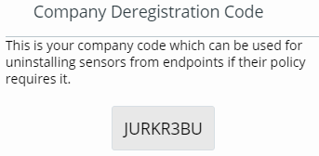
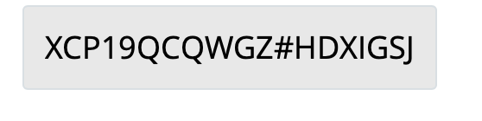
Uninstall.exe > EDR
Uninstalling EDR from the machine is entirely viable
Password = optional
Secure passwords?
Answer: Sometimes, Impossible
Why?
Limited character set (alphanumeric (caps only))
Static, relatively small password length of 8
Bruteforceable?
VS
Install code
Uninstall code
Notes:
Kinda funny, the registration code was about double the length of the deregistration code (shows what they're concerned about)
Sometimes impossible to generate a secure code as its automatically handled and cannot be manually set
Don't even need to brute-force on the host, can copy out the necessary files and brute-force the keygen algorithm until it satisfies the match condition, then use any code that satisfies that check on the target (bonus if its a company-wide deregistration code vs a device specific code)

Slide 22
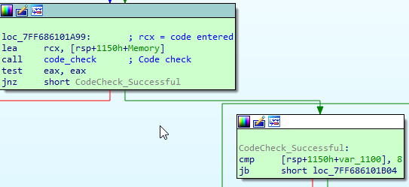
Uninstall.exe Pt.2
How about something easier, like falsifying the code check result?
Notes:
uninstall.exe 1 /code 12345678 (triggers the code path to uninstall using code 12345678)
uninstall64.exe+0x1A99 (location of uninstall code check)

Slide 23
For fun: Removing Callbacks
Demo!
Notes:
Another possibility here: patch the callback in the EDR driver to return on entry
This essentially blinds the EDR product
Requires kernel code exec (doesn't need to be in the form of a driver e.g. a kernel exploit or even kernel debugger)

Slide 24
Bypassing Hooks Completely
EDR’s main behavioural detection capabilities come from a hooked NTDLL loaded into most processes, therefore a few bypasses exist:
Inline assembly
Dynamically loading an unhooked NTDLL
Result? Complete bypass
Demo!
Notes:
This is the generic bypass method I bet some of you thought of in the previous slides, this works against multiple EDR products like cylance and carbon black etc.
This can be used on closed source binaries or open-source code.
NTDLL patched at process creation, not monitored/injected afterwards
Can re-patch to fixup, or use inline assembly, or load a fresh unpatched NTDLL, or whatever else you come up with. In this example I'll load and use an unhooked ntdll to perform risky API calls with (e.g. mimikatz's NtReadVirtualMemory).
And its that simple!

